Slide 1
Optical properties of interconnected plasmonic nanostructures with sub-10 nm nanogaps by area-selective atomic layer deposition
Brian Willis
John Grasso, Chengwu Zhang, Rahul Raman
University of Connecticut
Notes:
The topic of my presentation is related to the field of Plasmonics, so I will begin with a brief explanation of plasmons.

Slide 2
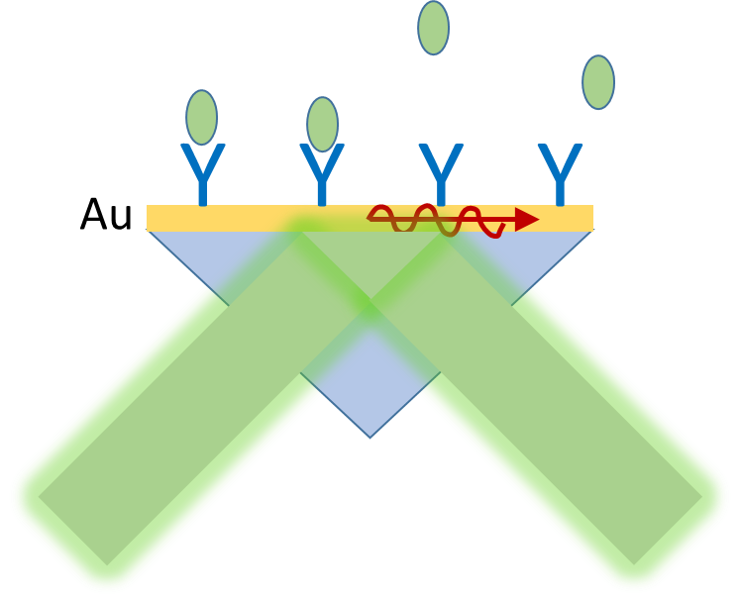

Introduction: What Are Plasmons?
Cu, Ag, Au
Plasmons are collective excitations of the electron gas for conductive materials:
“The nature of this charge density wave, known as a plasma oscillation or plasmon, can be understood in terms of a very simple model. Imagine displacing the entire electron gas, as a whole, through a distance d with respect to the fixed positive background of the ions…observation of energy losses in multiples of ħω when electrons are fired through thin, metallic films” Ashcroft & Mermin.
SPR Instruments for Biotech
a=15.3 eV
XPS Al 2s
Nanoparticles 10s-100s nm
XPS Handbook, Perkin Elmer
Bulk Plasmons
Surface Plasmons
Localized Surface Plasmon
Resonances (LSPR)
Notes:
For those of you who are unfamiliar with plasmonics, plasmons are described as collective excitations of the electron gas in a conductive material. The most common plasmonic materials are Cu, Ag, and Au. Ag has the most intense plasmon resonances, but Au is more commonly used due to its inert chemical properties. Cu has similar optical properties as Au and may be more practical for device applications.
A&M describe plasmons as charge density waves and conceptualize them as moving the electron gas as a whole wrt the fixed positive ions. So it is like an oscillation of the electron gas.
Bulk plasmons can be seen as loss features in some spectroscopiy measurements such as the X-ray photoelectron spectroscopy data for the Al 2s peak shown in the left figure, where several loss peaks occur, separated by the plasmon energy.
Surface plasmons are commonly used in biotechnology in the configuration shown in the middle image with a thin layer of Au on a glass prism. Surface plasmons are excited by light and their propagation is very sensitive to the refractive index of the adjacent medium. They can be used to detect biomolecule binding events.
Localized plasmons are found in small nanoparticles and nanostructures with sizes generally in the range of 10 to a few hundred nm. These Localized plasmon resonances are the subject of my talk.

Slide 3
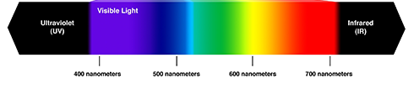
Introduction: Why are LSPR useful?
LSPR optical properties are tunable from UV to IR by the size & shape of nanostructures.
Overlap with Solar Spectrum: energy harvesting, photocatalysis, photodetectors, sensors
Nanoparticles: Cu, Ag, Au
Nanorods
Localized Surface Plasmon
Resonances (LSPR)
Notes:
Nanoparticle plasmons have been an active field lately because their optical properties can be tuned from the UV to the IR by designing nanoparticles with different sizes, shapes, and materials. This flexibility makes them highly interesting for applications in solar energy harvesting, photocatalysis, photodetectors, nanoscale heaters, biochemical sensors, and other applications.
The plot on the left shows how we can tune optical properties in the NIR by changing the sizes of Cu nanorods. The plot shows how optical transmission spectra shift with the sizes of the nanorods We can do tuning like this from the UV to the IR to overlap the solar spectrum.

Slide 4
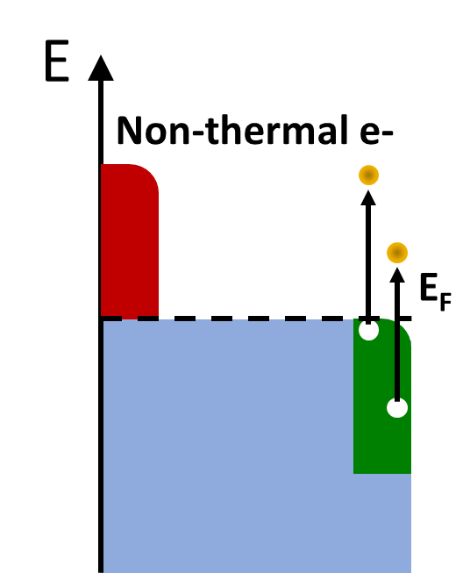
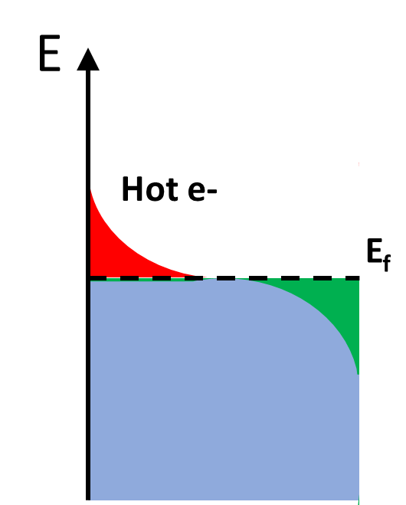
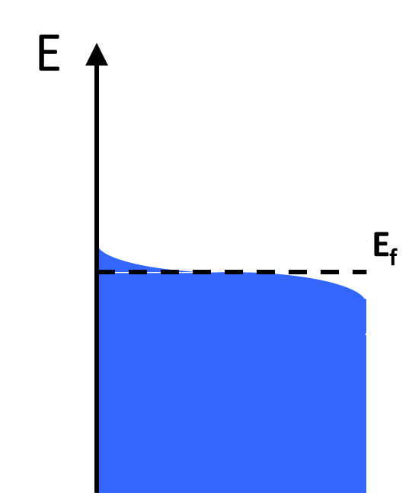
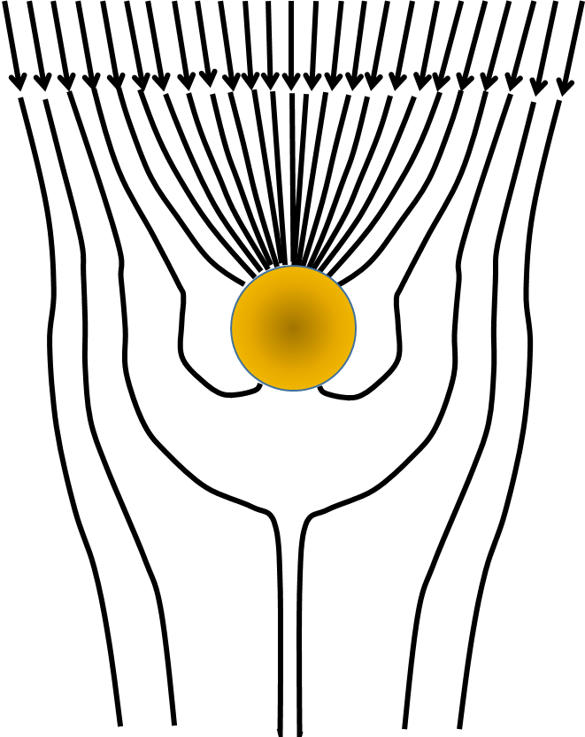
Introduction: What’s so special about LSPRs?
Time (fs-ps)
Plasmon
Damping
Hot Carriers
Heat
E >> E_{o}
+ + +
e-
e+
- - -
Antennas
High energy e-/e+
Hot T_{e} >>T_{L}
Thermalized
Notes:
Plasmon excitation and decay involves many complex physical processes.
Firstly, Plasmons have large extinction cross sections that give them antenna-like properties for efficient collection of light. Plasmons concentrate light energy in strongly enhanced near fields around the particles.
Second, plasmons decay into high energy carriers and hot carrier energy distributions that have potential to do useful work. The electrons and holes created by plasmon decay can have energies up to the incident photon energy.
Lastly, plasmon decay leads to heating, and particles can act as nanoscale heaters that can be useful for some applications. One creative example that I have seen is to inject nanoparticles into fat and use light to heat the particles and melt fat for improved liposuction medical procedures.

Slide 5
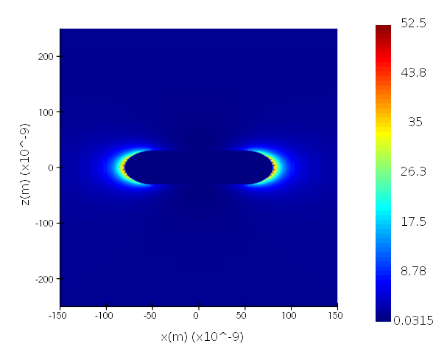
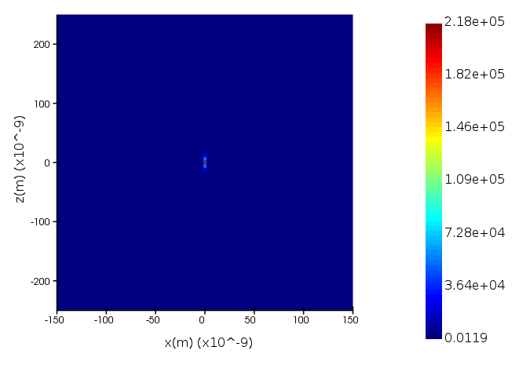
Introduction: Plasmonic Nanogaps
“hot spots”
2 nm
ROD
DIMER
|E|²
|E|²
̶ +
̶ +
LSPR create intense EM fields near Nanostructures & Nanoparticles
High EM fields promote hot carrier generation with applications in photocatalysis, spectroscopy, photodetection and energy harvesting.
Notes:
One of the characteristic features of plasmons is that they create very intense electric fields near the surfaces of nanostructures.
These electric fields are concentrated near sharp tips and edges such as the ends of nanorods, and especially in nanogaps formed by neighboring particles. The most intense electric fields are achieved for nanogaps around 1 nm. In the above examples field intensity enhancements are approximately 50 for the nanorods and over 10^5 for nanogaps of 2 nm. These types of nanogaps are often called EM “hot spots” in the literature.
The electric field intensity is directly related to the applications for plasmonics and so there has been a lot of interest to try to create nanogaps.
For those who don’t do nanofabrication, it is important to point out that current technology is limited to feature sizes on the order of 10 nm, so we can’t directly fabricate structures with 1 nm nanogaps, but we can design various processes to create nanogaps.
There have been a number of different approaches in the literature. I will discuss a process based on ALD. The nanoscale dimensions and need for precision are well suited to ALD.

Slide 6
Research Objectives
Adding interconnects to plasmonic nanostructures enables new types of devices: Nano / Plasmonic / Electrochemical / Electro-optic.
e⁻
How to contact Nanostructures without affecting LSPR?
How to create nanogaps down to 1 nm?
(without shorting nanorods)
Notes:
Our first research objective is to achieve nanogaps with sub-nm precision so that we can create devices with the most intense electric fields. When nanogaps are as small as 1 nm, charges can flow between particles via electron tunneling, which gives combined electrical and photonic functions.
Note that we don’t want the particles to touch, as that would completely change their optical properties.
Our second objective is to contact nanostructures without muting the plasmon resonances. Most studies of plasmonic materials have investigated particles suspended in solution or randomly deposited on surfaces. However, for new types of devices, we desire to make electrical contacts with nanostructures so that we can measure electrical charge flow from incident light, and vice versa.

Slide 7
ALD Strategies
100-200 nm
Area-selective ALD enables Cu deposition on Pd nanostructures
nanorods
50
50
nanogap
(cross-section views)
Cu
Cu
Cu
Cu
Pd
Au
Pd
Pd
Au
Au
Pd
Glass/ SiO2
Glass/ SiO2
Glass/ SiO2
Good growth, but poor optical properties
Better optical properties
Best optical properties
Notes:
Our ALD strategy is straightforward.
Cu is known to grow selectively on Pd surfaces so that we can start with Pd templates defined by lithography and then narrow nanogaps by adding conformal layers of Cu with ALD precision. This works well, but the optical properties of Cu/Pd structures are not very good since Pd is not a good plasmonic material.
A different strategy is to combine Pd with Au nanorods using only a thin Pd layer to activate Cu growth. This gives much better plasmonic properties due to the majority Au and Cu composition.
A 3rd strategy is to combine Au and Pd in heterodimers, where Cu deposition only takes place on Pd surfaces and the Au nanorods remain pure. This gives the best optical properties.
In this short talk I only have time to discuss the middle approach.

Slide 8
Optical Properties – FDTD Simulations
ALD will increase nanorod sizes, narrow nanogaps, modify shapes, & change materials
Au
Au
Glass/ SiO2
Increasing sizes cause plasmon resonances to redshift
Rounding shapes cause blue shifts
Heat Effects
Notes:
Before looking at data, it is useful to use a FDTD model to predict what might happen during ALD.
During ALD, we expect structures to get larger and to reduce nanogap sizes. We used EM simulations to investigate how ALD induced changes would be expected to modify the optical properties of plasmonic nanostructures.
The simulations produce extinction curves that characterize the optical responses of the nanostructures.
Simulations show that size increases and smaller nanogaps cause red shifts. In the left figure, we show how the extinction peak shifts to higher wavelength with increasing size.
We also investigated how shape changes from thermal heating affect extinction spectra. The simulations show that rounding corners and spheriodization cause blueshifts. The right figure shows how the extinction spectra blue shift with shape evolution.
Experimentally, we observe that blueshifts dominate.

Slide 9
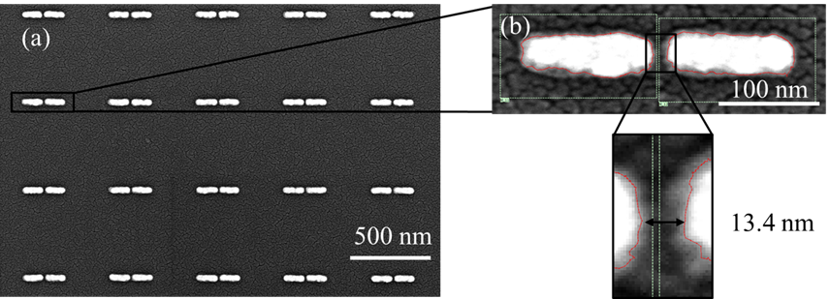
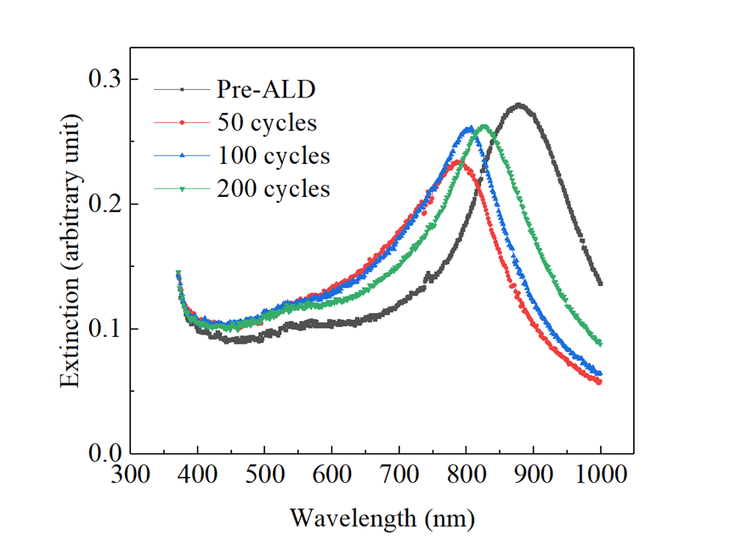
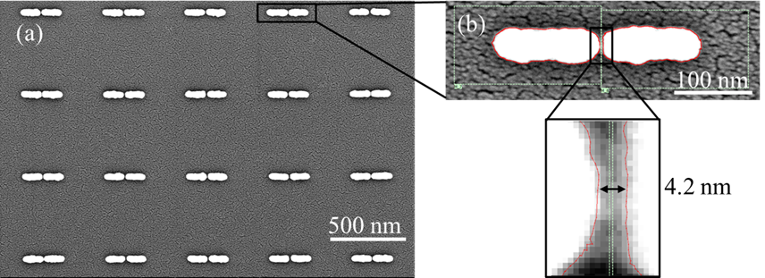
Nanogaps Fabricated by ALD
Plasmonic Dimers
Pre-ALD
Au
Au
Glass/ SiO2
Shape changes & shrinkage cause dominant blueshifts
Post-ALD with 200 cycles
Temp = 230ºC
Journal of Vacuum Science & Technology B 39, 053203 (2021).
ALD produces Plasmonic Nanogaps with sub-nm precision.
Notes:
Let’s first look at unconnected plasmonic dimers.
The idea (shown in upper left schematic) is that we can start with plasmonic dimers that have relatively large nanogaps near 15 nm using standard nanofabrication methods, and we can reduce nanogaps down to 1 nm by selectively coating nanostructures so they get bigger and the separation between them gets smaller. In this way, we have a process to control nanogaps with sub-nm precision. With this technique, we can create nanogaps and observe how the optical properties evolve.
The SEM figures on the right show an example where we reduced nanogaps from near 15 nm to < 5 nm through ALD, and the optical extinction data on the left show how the plasmon resonances change. We find that the resonances blue-shift and become sharper, but retain most of their original intensity. Other studies we have done show that the blue shift is primarily due to reshaping of the nanorods from heating effects.
With ALD, we have a scalable method to create EM hot spots for various applications.

Slide 10
Nanofabrication of Interconnected Dipole Arrays
Au Nanorods & Interconnects
Smaller nanogaps
Simulations
Experiment
550 nm unit cell
interconnect
Peak location/ intensity/ FWHM are comparable to unconnected dimers, but blue-shifted.
Notes:
The next objective is to learn how to contact nanostructures without diminishing these plasmon resonances. Here I show how we have added interconnects to plasmonic dimers. On the previous slide the nanorods were not connected, but here we have added interconnects that pass through the centers of each nanorod so that we have electrical connections.
The optical extinction data in the main plot on the right show intense resonances that are comparable to unconnected plasmonic dimers. There is also a new feature at 530 nm that we assign to the interconnect lines.
FDTD simulations shown in the inset plot provide a comparison of extinction peaks for nanorods with and without interconnects. The simulations reveal that adding 40 nm width interconnects causes a blue-shift (dashed line), but the peak intensity and fwhm are similar, which is consistent with our experiments. Simulations also show that the blueshift is proportional to the width of the interconnect lines. There is also a new feature at 530 nm, similar to experiments.
We can now combine the two experiments using ALD, and nanorods with interconnects to create nanogaps with electrical connections for new types of devices where photons and electrons interchange.

Slide 11
ALD with Interconnected Nanorods
CuPdAu Nanorods after 1000 cycles ALD at 230ºC
Length: 159 ± 3 → 167 ± 3 nm
Width: 54 ± 1 → 66 ± 3 nm
Nanogap: 14 ± 3 → 8 ± 2 nm
Small blueshift after ALD, same peak height
FDTD simulations show importance of alloy effects (red dashes) vs. pure Cu (blue dashes)
Lateral GPC ~ ½ vertical GPC

Slide 12
Conclusions
ALD is a promising technique for creating new electro-optic plasmonic devices with intense EM fields created by NANOGAPS in the 1 - 2 nm range.
ALD approach is compatible with INTERCONNECTS that give plasmon resonances similar to unconnected nanorods to combine electrical and optical functions.
Notes:
Nanogaps are small enough for molecule scale devices.
Interconnects allow for detection, emission, electrochemical utility

Slide 13
Acknowledgements
Harvard Center for Nanoscale Systems (CNS)
Office of Naval Research (ONR)
National Science Foundation (NSF)

Slide 14

Applications: Photodiodes
e⁻
$$φ_{B}$$
E_{f}
e⁻
metal
E_{g}
Si(n-type) or TiO₂
Hot electrons (& holes) overcome the Schottky Barrier to create Plasmonic Photodiodes with sub-bandgap wavelengths.
Notes:
One application that has been demonstrated is for photodetection using Schottky barrier diodes.
When plasmonic nanoparticles are in contact with a semiconductor like Si or TiO2, the high energy carriers created during plasmon decay can cross Schottky barriers to create photocurrents with sub-bandgap light that extends the photodetection wavelength range beyond bandgap limitations of the semiconductor.

