Slide 1
Optical properties of interconnected plasmonic nanostructures with sub-10 nm nanogaps by atomic layer deposition
Brian Willis
John Grasso, Chengwu Zhang, Rahul Raman
University of Connecticut
Notes:
The topic of my presentation is related to the field of Plasmonics, so I will begin with a brief explanation of plasmons.

Slide 2
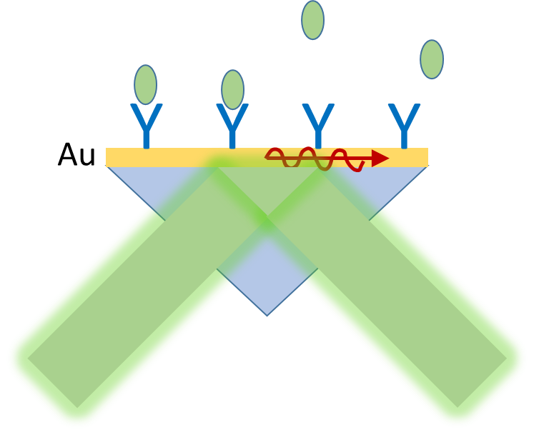

Introduction: What Are Plasmons?
Plasmons are collective excitations of the electron gas:
“The nature of this charge density wave, known as a plasma oscillation or plasmon, can be understood in terms of a very simple model. Imagine displacing the entire electron gas, as a whole, through a distance d with respect to the fixed positive background of the ions…observation of energy losses in multiples of ħω when electrons are fired through thin, metallic films” Ashcroft & Mermin.
Cu, Ag, Au
SPR Instruments for Biotech
a=15.3 eV
XPS Al 2s
Nanoparticles 10s-100s nm
XPS Handbook, Perkin Elmer
Bulk Plasmons
Surface Plasmons
Localized Surface Plasmon
Resonances (LSPR)
Notes:
The first thing to know is that there are different types of plasmons: bulk plasmons, surface plasmons, and localized surface plasmons.
Plasmons are commonly described as collective excitations of the electron gas in a conductive material. A&M describe them as charge density waves and conceptualize them as moving the electron gas as a whole wrt the fixed positive ions. So it is like an oscillation of the electron gas.
Bulk plasmons can be seen as loss features in some spectroscopiy measurements such as the X-ray photoelectron spectroscopy data for the Al 2s peak shown in the left figure, where several loss peaks occur, separated by the plasmon energy.
Surface plasmons are commonly used in biotechnology in the configuration shown in the middle image with a thin layer of Au on a glass prism. Surface plasmons are excited by light and their propagation is very sensitive to the refractive index of the adjacent medium. They can be used to detect biomolecule binding events.
Localized plasmons are found in small nanoparticles and nanostructures made of materials such as Cu, Ag, and Au with sizes generally in the range of 10 to a few hundred nm. These Localized plasmon resonances are the subject of my talk.

Slide 3
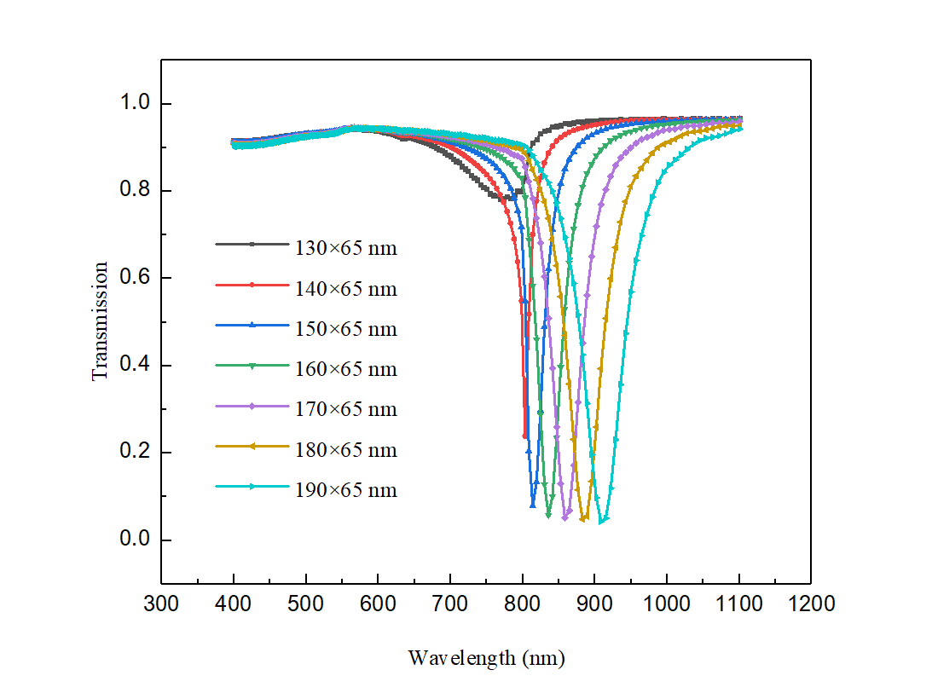
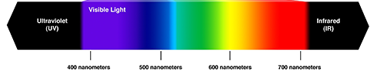
Introduction: Why are LSPR useful?
LSPR optical properties are tunable from UV to IR by the size & shape of nanostructures.
Overlap with Solar Spectrum: energy harvesting, photocatalysis, photodetectors, sensors
Nanoparticles: Cu, Ag, Au
Localized Surface Plasmon
Resonances (LSPR)
Notes:
Nanoparticle plasmons have been a hot field lately because their optical properties can be tuned from the UV to the IR by designing nanoparticles with different sizes, shapes, and materials. This flexibility makes them highly interesting for applications in solar energy harvesting, photocatalysis, photodetectors, nanoscale heaters, biochemical sensors, and other applications.
The plot on the left shows how we can tune optical properties in the NIR by changing the sizes of Cu nanorods. The plot shows how optical transmission spectra shift with the sizes of the nanorods We can do tuning like this from the UV to the IR to overlap the solar spectrum.

Slide 4
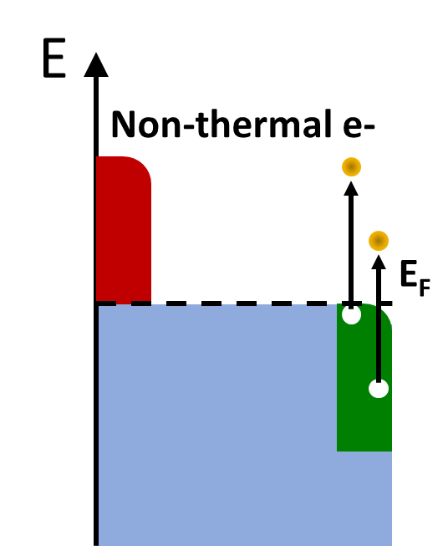
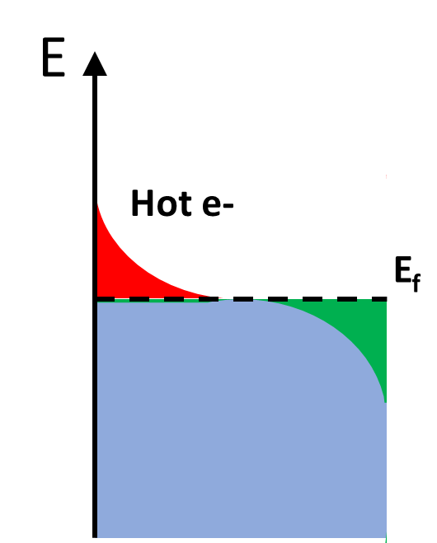
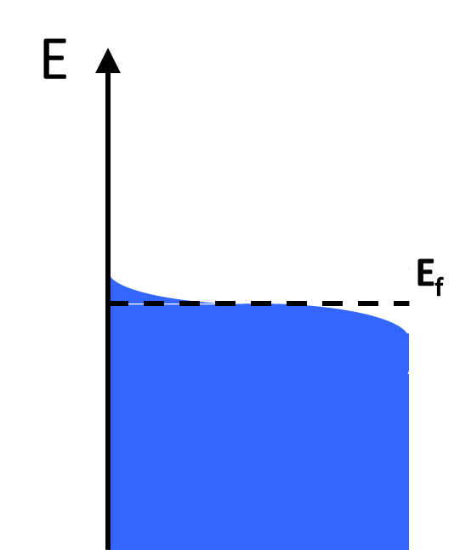
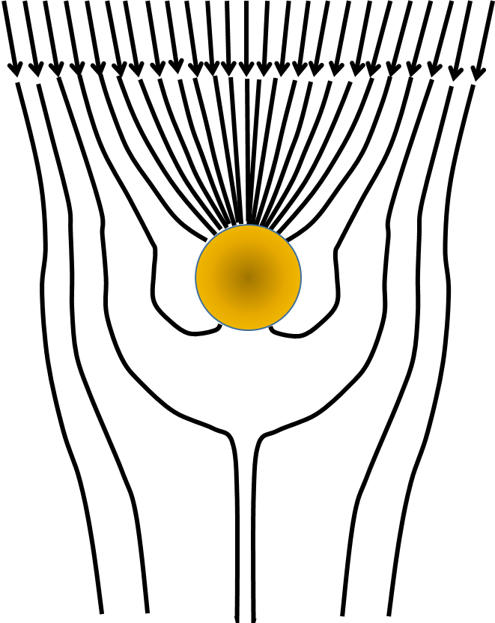
Introduction: What’s so special about LSPRs?
Time (fs-ps)
Plasmon
Damping
Hot Carriers
Heat
E >> E_{o}
+ + +
e-
e+
- - -
Antennas
High energy e-/e+
Hot T_{e} >>T_{L}
Thermalized
Notes:
What is so special about plasmons?
Well, A couple of things are special:
Firstly, they have large extinction cross sections that give them antenna-like properties for efficient collection of light.
Second, plasmons decay into high energy carriers and hot carrier energy distributions that have potential to do useful work. The electrons and holes created by plasmon decay can have energies up to the incident photon energy.
Lastly, plasmon decay leads to heating, and particles can act as nanoscale heaters that can be useful for some applications. One example that I have seen is to inject nanoparticles into fat and use light to heat the particles and melt fat for improved liposuction medical procedures.

Slide 5

Applications: Photodiodes
e⁻
$$φ_{B}$$
E_{f}
e⁻
metal
E_{g}
Si(n-type) or TiO₂
Hot electrons (& holes) overcome the Schottky Barrier to create Plasmonic Photodiodes with sub-bandgap wavelengths.
Notes:
For this community interested in nanoelectronics and nanophotonics, one application that has been demonstrated is for photodetection using Schottky barriers.
When plasmonic nanoparticles are in contact with a semiconductor like Si or TiO2, the high energy carriers created during plasmon decay can cross Schottky barriers to cause a photocurrent with sub-bandgap light that extends the photodetection wavelength range beyond bandgap limitations of the semiconductor.
These kinds of designs have potential applications as nanoscale light detectors and emitters.
So far, efficiency is low, and that motivates continued research to improve device performance.

Slide 6
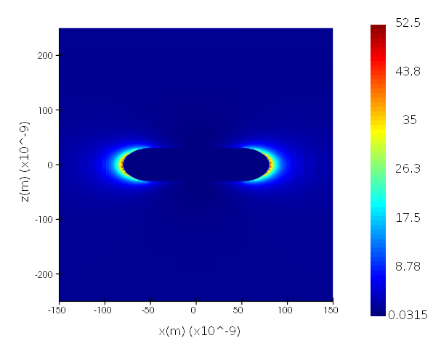
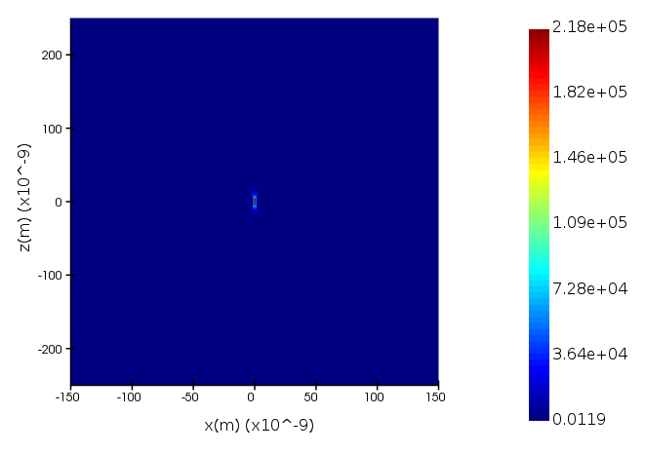
Introduction: Plasmonic Nanogaps
2 nm
ROD
DIMER
|E|²
|E|²
LSPR create intense EM fields near Nanostructures & Nanoparticles
High EM fields promote hot carrier generation with applications in photocatalysis, spectroscopy, photodetection and energy harvesting.
Notes:
One of the unique features of plasmons is that they create very intense electric fields near the surfaces of nanostructures from the electron gas oscillations.
These electric fields are concentrated near sharp tips and edges such as the ends of nanorods, and especially in nanogaps formed by neighboring particles. The most intense electric fields are achieved for nanogaps around 1 nm. In the above examples field intensity enhancements are approximately 50 for the nanorods and over 100,000 for nanogaps of 2 nm. These types of nanogaps are often called EM “hot spots” in the literature.
The electric field intensity is directly related to the applications for plasmonics and so there has been a lot of interest to try to create nanogaps.
For those who don’t do nanofabrication, it is important to point out that current technology is limited to feature sizes on the order of 10 nm, so we can’t directly fabricate structures with 1 nm gaps, but we can design various processes to create nanogaps.
I will discuss a process based on ALD.

Slide 7
Research Objectives
Adding interconnects to plasmonic nanostructures enables new types of devices: Nano / Plasmonic / Electrochemical / Electro-optic.
e⁻
How to create nanogaps down to 1 nm?
How to improve device efficiency?
How to contact Nanostructures without affecting LSPR?
Notes:
Our first research objective is to achieve nanogaps with sub-nm precision so that we can create devices with the most intense electric fields. When nanogaps are as small as 1 nm, charges can flow between particles via electron tunneling, which gives combined electrical and photonic functions.
Note that we don’t want the particles to touch, as that would completely change their optical properties.
Our second objective is to contact nanostructures without muting the plasmon resonances. Most studies of plasmonic materials have investigated particles suspended in solution or randomly deposited on surfaces. However, for new types of devices, we desire to make electrical contacts with nanostructures so that we can measure electrical charge flow from incident light, and vice versa.

Slide 8
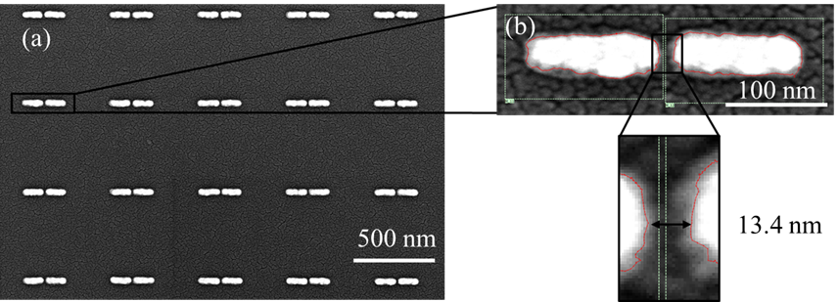
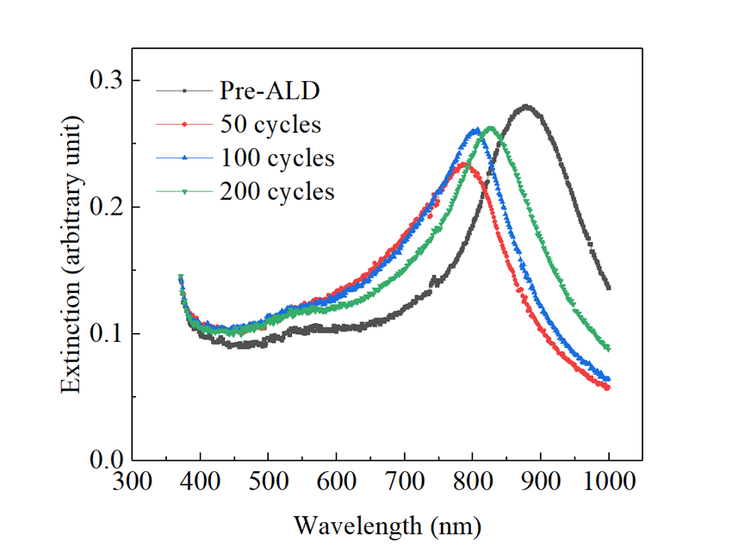
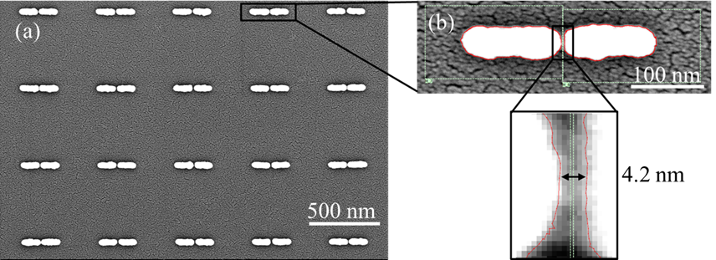
Nanogaps Fabricated by ALD
Plasmonic Dimers
nanogap
Pre-ALD
Glass/ SiO2
Post-ALD with 200 cycles
Journal of Vacuum Science & Technology B 39, 053203 (2021).
ALD produces Plasmonic Nanogaps with sub-nm precision.
21
Notes:
First, I will address Nanogap formation.
Atomic layer deposition or ALD is a method for depositing thin films in the semi industry with Angstrom precision, and it can be made selective so that growth only occurs on nanostructures.
The idea (shown in upper left schematic) is that we can start with plasmonic dimers that have relatively large nanogaps near 15 nm using standard nanofabrication methods, and we can reduce nanogaps down to 1 nm by selectively coating nanostructures so they get bigger and the separation between them gets smaller. In this way, we have a process to control nanogaps with sub-nm precision. With this technique, we can create nanogaps and observe how the optical properties evolve.
The SEM figures on the right show an example where we reduced nanogaps from near 15 nm to < 5 nm through ALD, and the optical extinction data on the left show how the plasmon resonances change. We find that the resonances blue-shift and become sharper, but retain most of their original intensity. Other studies we have done show that the blue shift is primarily due to reshaping of the nanorods from heating effects.
With ALD, we have a scalable method to create EM hot spots for various applications.

Slide 9
Nanofabrication of Interconnected Dipole Arrays
Smaller nanogaps
Simulations
550 nm unit cell
interconnect
Experiment
Sharp resonances are achievable for interconnected dipoles.
Peak location/ FWHM are comparable to unconnected dimers, but blue-shifted.
Notes:
The next objective is to learn how to contact nanostructures without diminishing these plasmon resonances. Here I show how we have added interconnects to plasmonic dimers. On the previous slide the nanorods were not connected, but here we have added interconnects that pass through the centers of each nanorod so that we have electrical connections.
The optical extinction data in the main plot on the right show intense resonances that are comparable to unconnected plasmonic dimers. There is also a new feature at 530 nm that we assign to the interconnect lines.
FDTD simulations shown in the inset plot provide a comparison of extinction peaks for nanorods with and without interconnects. The simulations reveal that adding 40 nm width interconnects causes a blue-shift (dashed line), but the peak intensity and fwhm are similar, which is consistent with our experiments. Simulations also show that the blueshift is proportional to the width of the interconnect lines. There is also a new feature at 530 nm, similar to experiments.
We can now combine the two experiments using ALD, and nanorods with interconnects to create nanogaps with electrical connections for new types of devices where photons and electrons interchange.

Slide 10
Conclusions
ALD is a promising technique for creating new types of electro-optic plasmonic devices with intense EM fields created by nanogaps in the 1 - 5 nm range.
Additionally, we can add interconnects and create plasmon resonances similar to unconnected nanorods to combine electrical and optical functions. This may lead to new devices.

Slide 11
Acknowledgements
Chengwu Zhang (ASM, Phoenix AZ)
John Grasso (UConn)
Rahul Raman (UConn)
Harvard Center for Nanoscale Systems (CNS)
Office of Naval Research (ONR)
National Science Foundation (NSF)

